Slide 1

Software Development tooling: Git
Seth Russell – seth.russell@cuanschutz.edu
SOM, Dept of Pediatrics, Section of Informatics and Data Science
Code & Presentations: https://github.com/magic-lantern/bios6642-2022
Survey: https://forms.gle/yZNk6TQMKUP8y8eCA
Notes:
Introductions:
Names
programming experience
Statistics or research experience

Slide 2
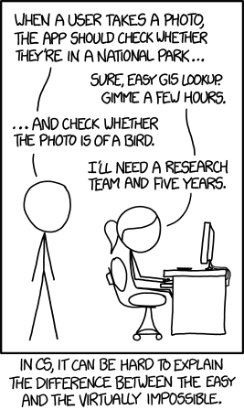
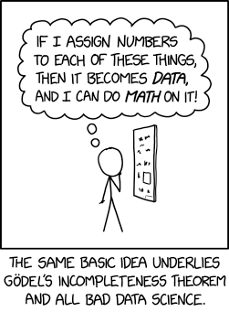
Developing Software
https://xkcd.com/2610/
https://xkcd.com/1425/
https://github.com/magic-lantern/bios6642-2022
Notes:
“The first incompleteness theorem states that in any consistent formal system F within which a certain amount of arithmetic can be carried out, there are statements of the language of F which can neither be proved nor disproved in F.”

Slide 3
Developing Software – and papers
my_awesome_file.py
my_awesome_file2.py
my_awesome_fie3.py
my_awesome_file3.py
my_awesome_file_changes.py
my_awesome_file_final.py
my_awesome_file_final_final.py
my_awesome_file_PI_feedback.py
…
https://github.com/magic-lantern/bios6642-2022
Notes:
Many people when writing important papers or software realize the important of being able to go back to a previous version. This is how many people solve the problem – manually creating a new version when they make a large change, are close to a deadline, or get critical feedback from fellow student, instructor, PI, etc.
Just because you haven’t been bit by losing a version of something you are working on doesn’t mean it won’t happen

Slide 4
Version Control Software
“Did you think the lion was sleeping because he didn't roar?” ― Friedrich Schiller, Die Verschwörung des Fiesco zu Genua
https://github.com/magic-lantern/bios6642-2022
Notes:
Luckily there is a better way.
In the process of solving – or creating – problems using software. There will be many times where you or those directing you change their mind. Version control software can help you to recover previous versions, undo mistakes, understand how something was developed, or provide important documentation.
Since the mid 1980’s people have been developing software to help manage their software. The current industry recognized best and open source solution for version control is Git. While I’ll be talking about git, the concepts, techniques and workflow you learn from Git can be applied to other version control software and are an important part of the software development process.
Just because you haven’t lost a significant amount of work, doesn’t mean it can’t happen to you at some point in the future.

Slide 5

Why Git Rules the world (of software)
https://www.atlassian.com/git/tutorials/why-git
Notes:
Git has branching
Decentralized workflow
Support for multiple people working on the same thing at the same time – though only really works with text files.

Slide 6
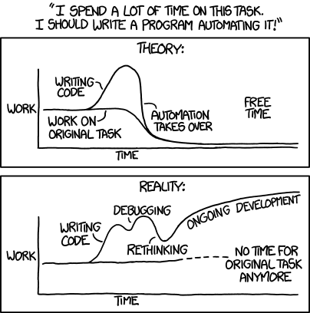
Developing Software
https://xkcd.com/1319/
https://github.com/magic-lantern/bios6642-2022
Notes:
Alt-text: "'Automating' comes from the roots 'auto-' meaning 'self-', and 'mating', meaning 'screwing'."

Slide 7
Why Git Rules the world
Save Time
Git is lightning fast. And although we're talking about only a few seconds per command, it quickly adds up in your work day. Use your time for something more useful than waiting for your version control system to get back to you.
Work Offline
What if you want to work while you're on the move? With a centralized VCS like Subversion or CVS, you're stranded if you're not connected to the central repository. With Git, almost everything is possible simply on your local machine: make a commit, browse your project's complete history, merge or create branches... Git let's you decide where and when you want to work.
https://www.git-tower.com/learn/git/ebook/en/command-line/appendix/why-git
https://github.com/magic-lantern/bios6642-2022

Slide 8

Developing Software Standards
https://xkcd.com/927/
https://github.com/magic-lantern/bios6642-2022

Slide 9
Why Git Rules the world
Undo Mistakes
People make mistakes. A good thing about Git is that there's a little "undo" command for almost every situation. Correct your last commit because you forgot to include that small change. Revert a whole commit because that feature isn't necessary, anymore. And when the going gets tough you can even restore disappeared commits with the Reflog - because, behind the scenes, Git rarely really deletes something. This is peace of mind.
Don't Worry
Git gives you the confidence that you can't screw things up - and this is a great feeling. In Git, every clone of a project that one of your teammates might have on his local computer is a fully usable backup. Additionally, almost every action in Git only adds data (deleting is very rare). That means that losing data or breaking a repository beyond repair is really hard to do.
https://www.git-tower.com/learn/git/ebook/en/command-line/appendix/why-git
https://github.com/magic-lantern/bios6642-2022

Slide 10
Why Git Rules the world
Don’t Mix Things Up
Separation of concerns is paramount to keeping track of things. While you’re working on feature A, nothing (and no-one) else should be affected by your unfinished code. What if it turns out the feature isn’t necessary anymore? Or if, after 10 commits, you notice that you took a completely wrong approach? Branching is the answer for these problems. And while other version control systems also know branches, Git is the first one to make it work as it should: fast & easy.
https://www.git-tower.com/learn/git/ebook/en/command-line/appendix/why-git
https://github.com/magic-lantern/bios6642-2022
Notes:
These reasons have made git adoption very rapid such that today it seems almost everyone uses git.
Stackoverflow 2021 report indicates that about 93% of survey respondents work with Git (https://insights.stackoverflow.com/survey/2021#section-most-popular-technologies-other-tools)
Whether or not you do actually use git or some other version control software, the principles reviewed here will be beneficial for all of you in your current and future work with any software, text, documents, or even files developed in a digital format.

Slide 11
Common Terms
git checkout
git status
git add
git commit
git push
git pull
git branch
git log
https://github.com/magic-lantern/bios6642-2022
Notes:
Explain briefly what each of these do.
Demonstration?

Slide 12
Status check
https://cups.fast.ai/gitandweb
Notes:
https://cups.fast.ai/gitandweb/teacher

Slide 13
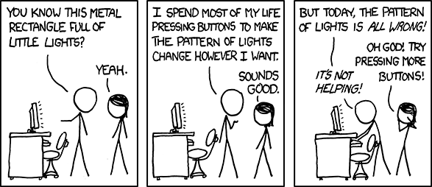
Complex Software
https://xkcd.com/722/
https://github.com/magic-lantern/bios6642-2022

Slide 14
Best Practices Git
Make git part of your workflow. Git integrates with RStudio, Visual Studio Code, and many other common editors
Commit at least daily – preferably anytime you solve a major problem or have done something worth keeping
Push changes immediately after a commit
Write detailed commit messages. Your future self will thank you!
Everything committed can be undone.
Do not commit passwords, Protected Health Information, or other sensitive data
https://github.com/magic-lantern/bios6642-2022
Notes:
Coalary to “Everything committed can be undone” – Code not committed might as well not exist
? Show commit history example.
? Example of multiple people working together

Slide 15
Best Practices Git
When Working with others:
Commit often
Branching is helpful
Pull before you push
https://github.com/magic-lantern/bios6642-2022
Notes:
Coalary to “Everything committed can be undone” – Code not committed might as well not exist
? Show commit history example.
? Example of multiple people working together

Slide 16
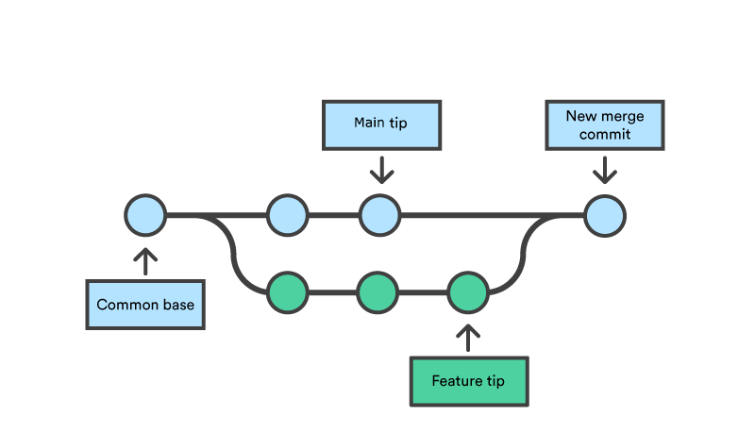
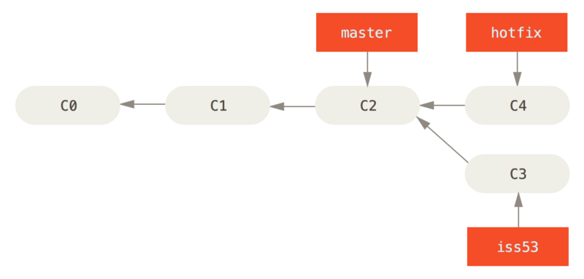
Git Branching
https://github.com/magic-lantern/bios6642-2022
Notes:
To provide more explanation on what branching is: All commits in a git repo can be considered a fixed point in time that a near infinite number of code splits can occur from. Similar to how a tree can have branches from the main trunk and each branch can have branches etc. until you end at a leaf, git allows every commit to be the start of a new branch.
<Click to show first version>
However, unlike a tree, any branch can also be merged with any other branch at any time.
<click to show next image>
By convention, all git repositories have a primary branch or trunk, most often called “main” or “master” In general most code changes will be added to this primary branch unless there is a need to separate work from other work. Typically, this is done when a breaking change is being developed or someone wants to try out an idea that may be thrown away.
There are many different strategies for branching. The best strategy for a project will depend on factors such as number of people working on a project, number of separate work streams involved in the project, and other considerations.
Similarly There are also different strategies for how many git repositories to create.

Slide 17
Git limitations
Complexity (geared toward command-line)
Binary files
Lack of fine-grained security controls
https://github.com/magic-lantern/bios6642-2022
Notes:
Git cannot generate useful differences between binary files nor merge binary files between branches. Also as every clone (local copy of a git repo) stores the entire history, binary files can make cloning slow or take a large amount of disk space

Slide 18

Notes:
While Git is open source, there are many websites that offer git hosting along with additional functionality.
Github is very common. Other options include BitBucket, GitLab, and more.
Clicking sign in takes you to your browser to use/setup a github.com account

Slide 19
How to get Git
https://desktop.github.com/
https://www.gitkraken.com/
Your favorite IDE & OS – plugin may be required
JetBrains’ products
MATLAB
Rstudio
Visual Studio/Visual Studio Code
vim
https://github.com/magic-lantern/bios6642-2022

Slide 20
Status check
Close your browser window first if you still have it open
https://cups.fast.ai/gitandweb
Notes:
https://cups.fast.ai/gitandweb/teacher

Slide 21
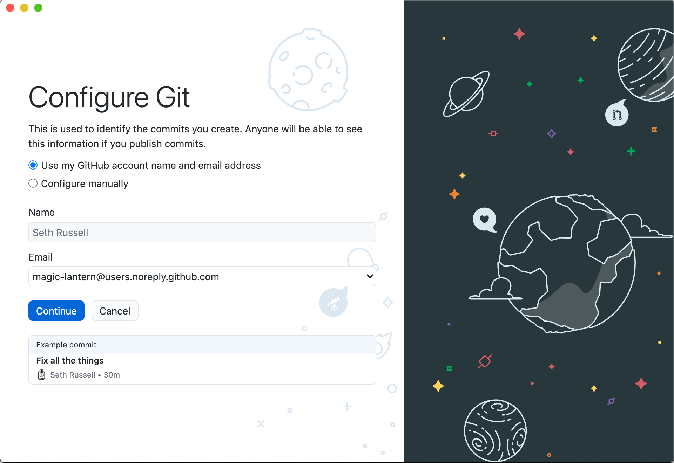
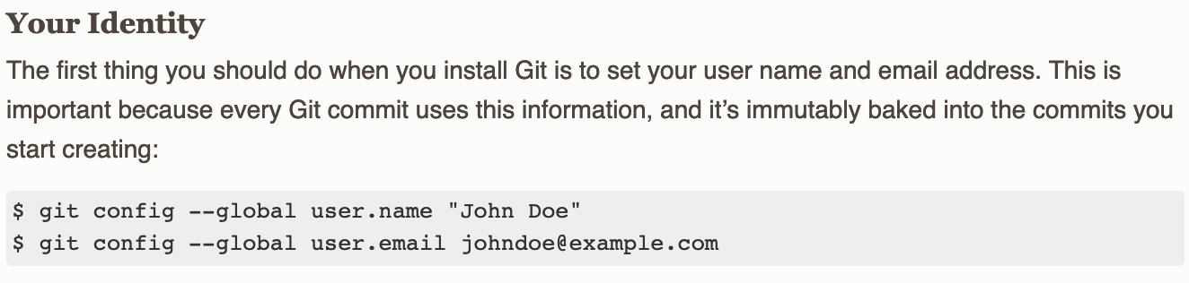

Slide 22

Notes:
While Git is open source, there are many websites that offer git hosting along with additional functionality.
Github is very common. Other options include BitBucket, GitLab, and more.
Clicking sign in takes you to your browser to use/setup a github.com account

Slide 23
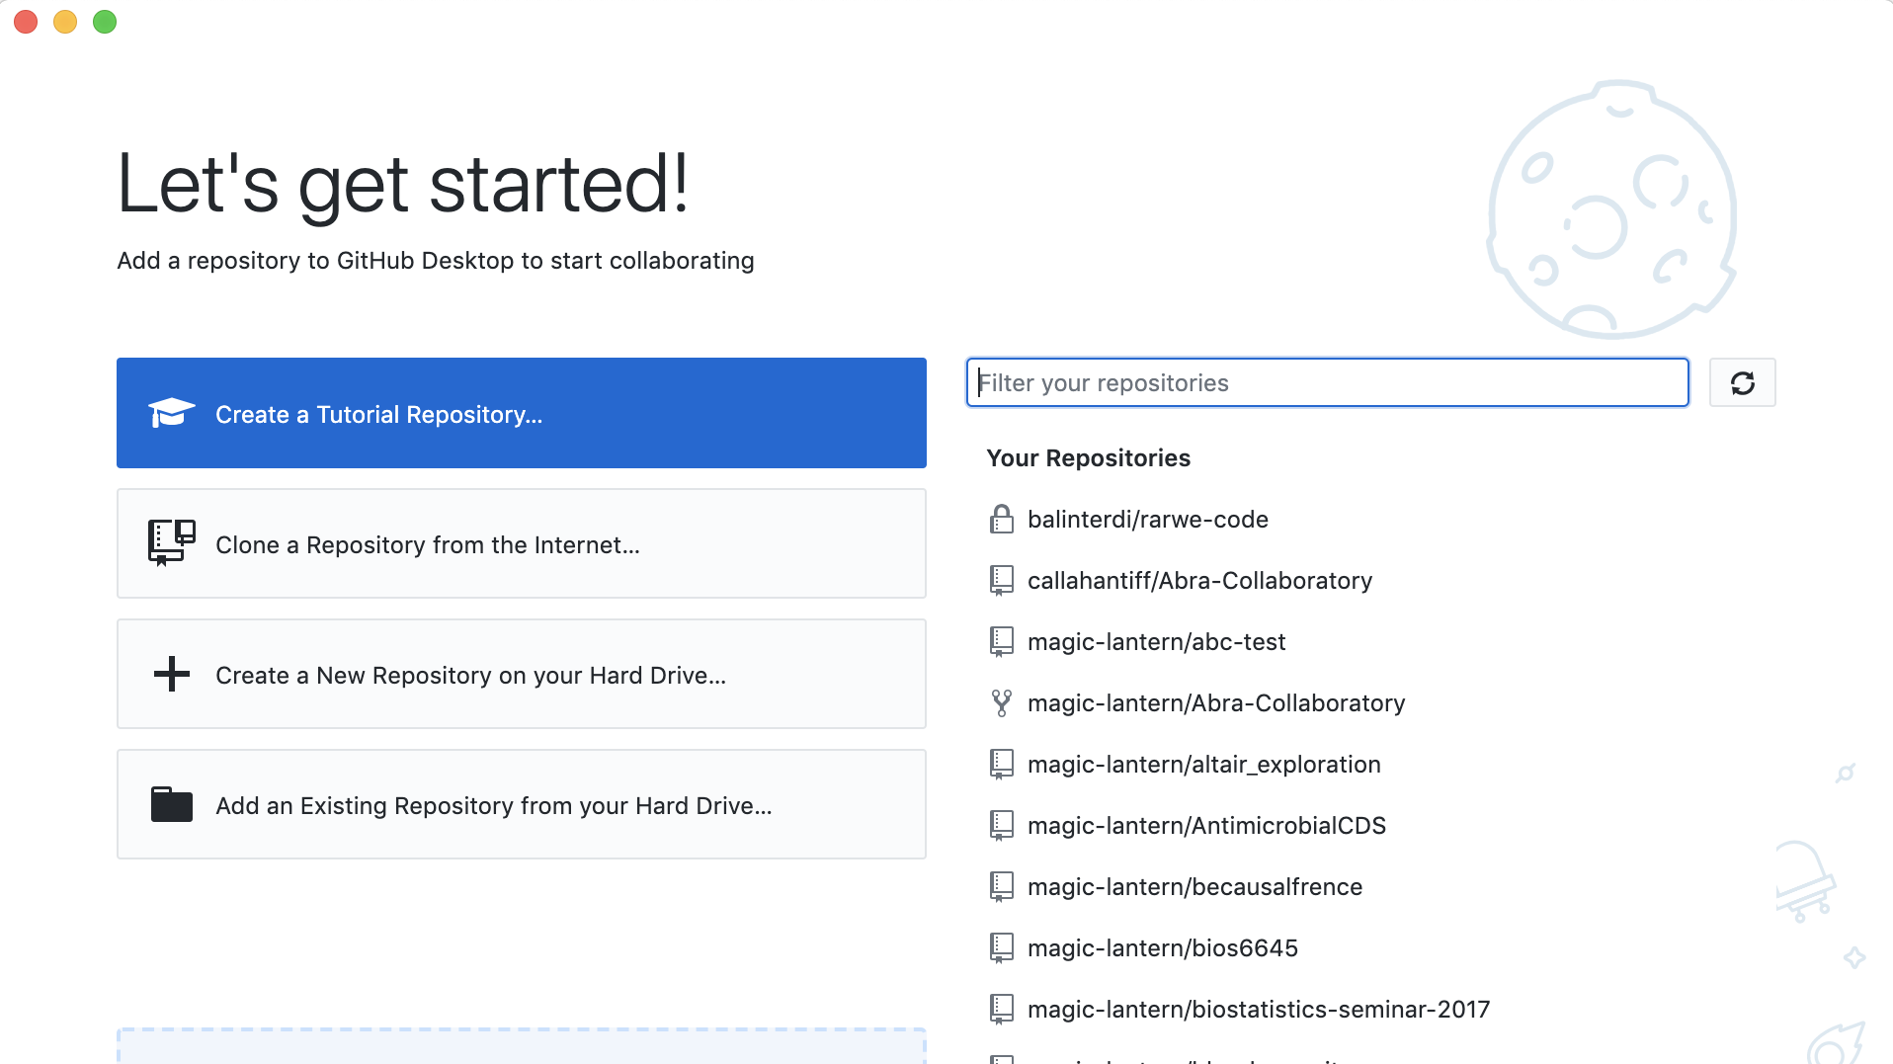

Slide 24
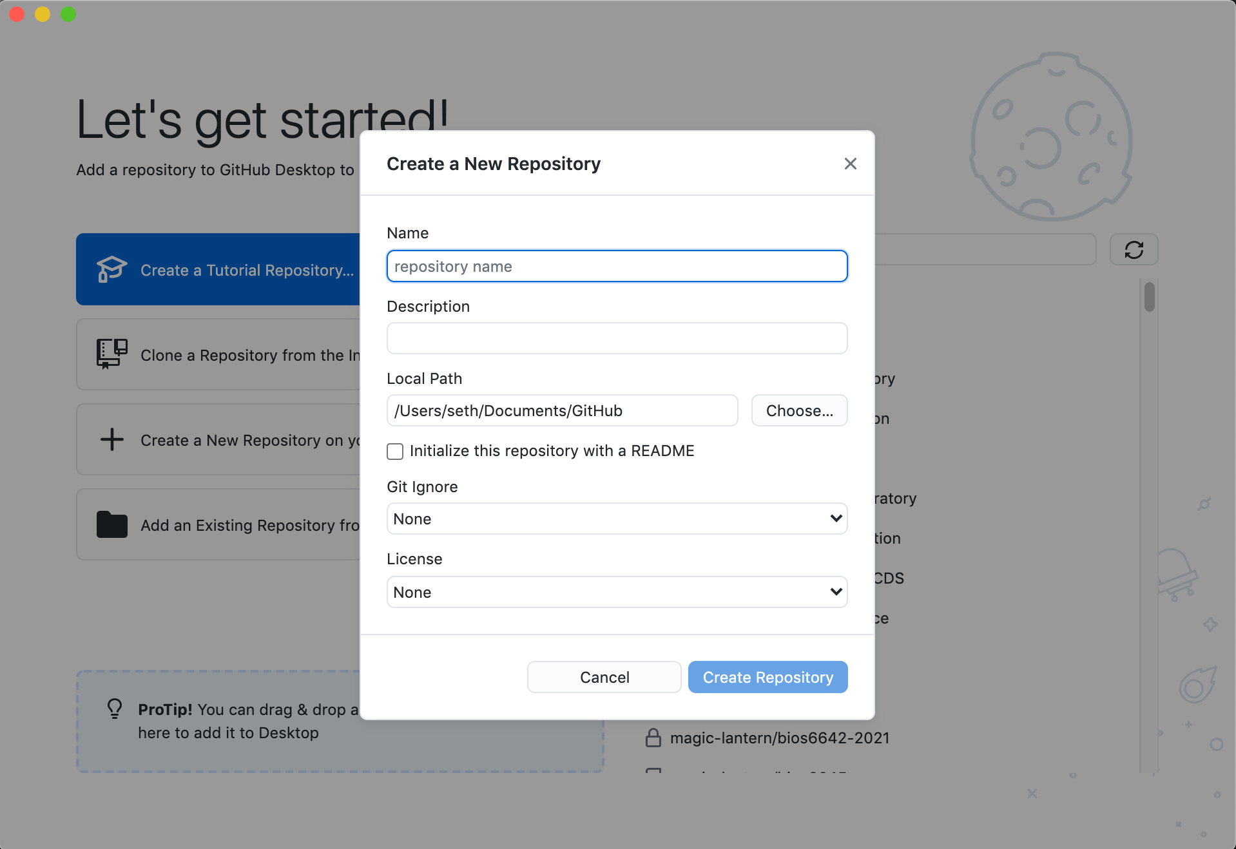

Slide 25
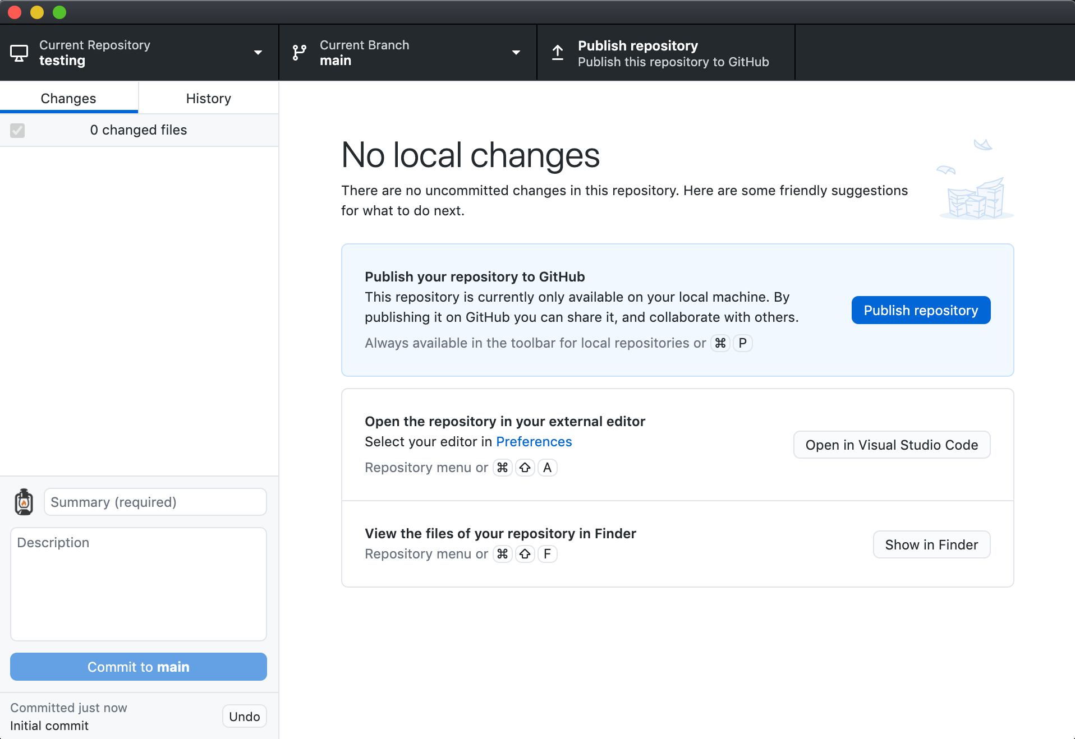
Notes:
While Git is open source, there are many websites that offer git hosting along with additional functionality.
Github is very common. Other options include BitBucket, GitLab, and more.
Clicking sign in takes you to your browser to use/setup a github.com account

Slide 26
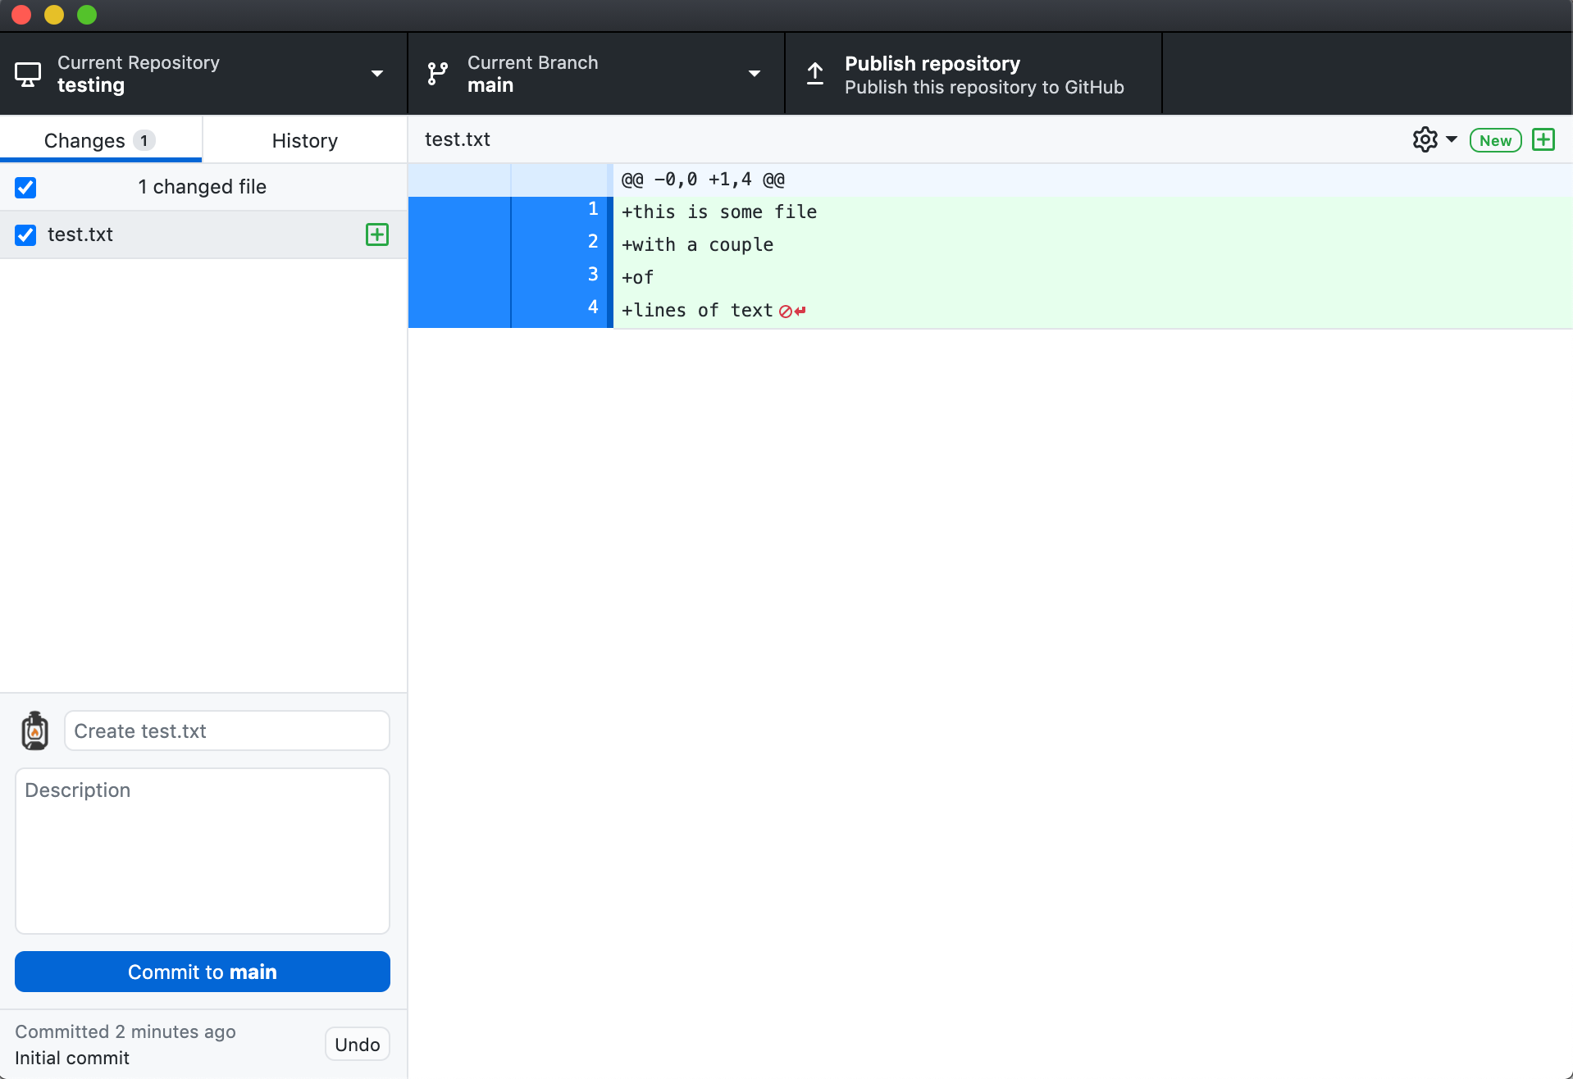

Slide 27
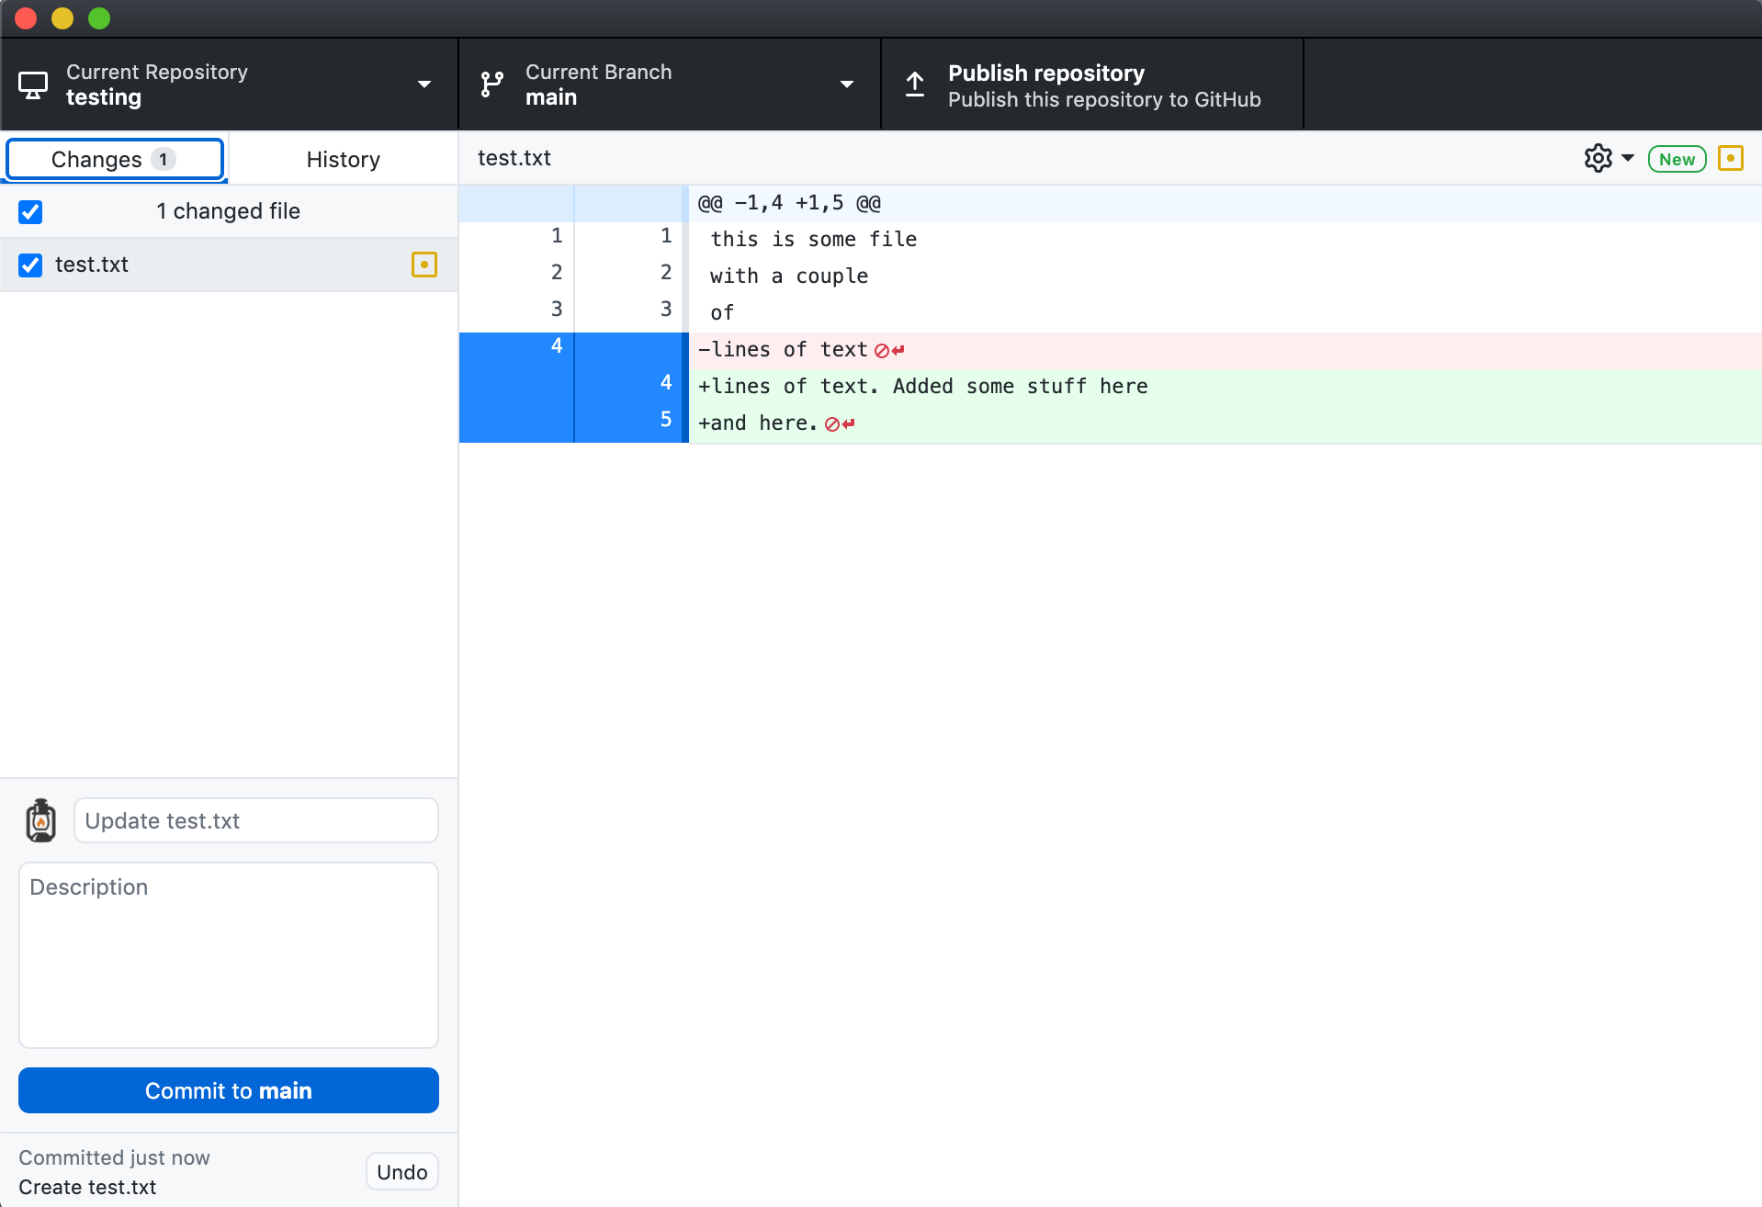

Slide 28
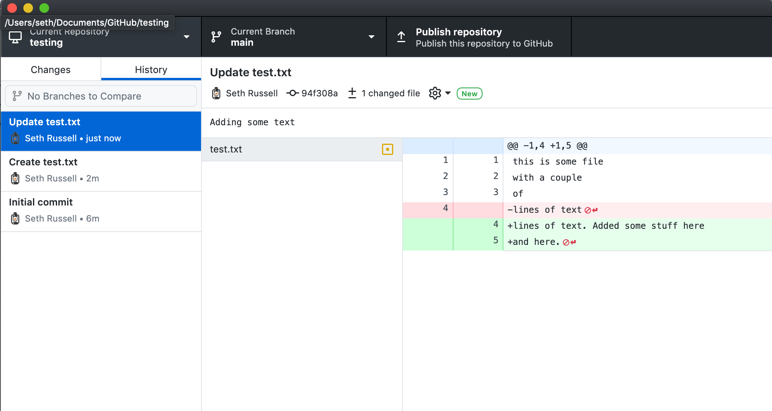

Slide 29
Version Control
What deep wounds ever closed without a scar?
Lord Byron
https://github.com/magic-lantern/bios6642-2022
Notes:
Sometimes the best way to learn is by getting hurt.
My recommended method would be similar to learning to ride a bike.The best way to learn to ride a bike is by getting on a bike – but wear a helmet and practice in a safe place.
It’s better to learn how to use the tool and begin using it before you’ve lost some important work.

Slide 30
Status check
Close your browser window first if you still have it open
https://cups.fast.ai/gitandweb
Notes:
https://cups.fast.ai/gitandweb/teacher

Slide 31



Collaborating with others
“Fork” a repo
https://github.com/magic-lantern/bios6642-2022
Notes:
Great way to start is by working on a project that you already use. Documentation and issues are great places to start.
The term used for collaborating with others in Github is to “Fork” a repo. No it’s not the same as the eating utensil. What it is is a clone, followed by several commits and then a request to someone else that they merge your changes into their repo.
Every git repository is a full copy of the original. Any copy of a repo can push and pull to any other copy of a repo. However, by convention, we treat the copy of the repo stored on GitHub’s server as the primary copy and all other copies as less important clones.
Remember to create focused commits – only fix 1 thing at a time. If you are fixing documentation for Feature X, don’t also commit something for Feature Y.

Slide 32
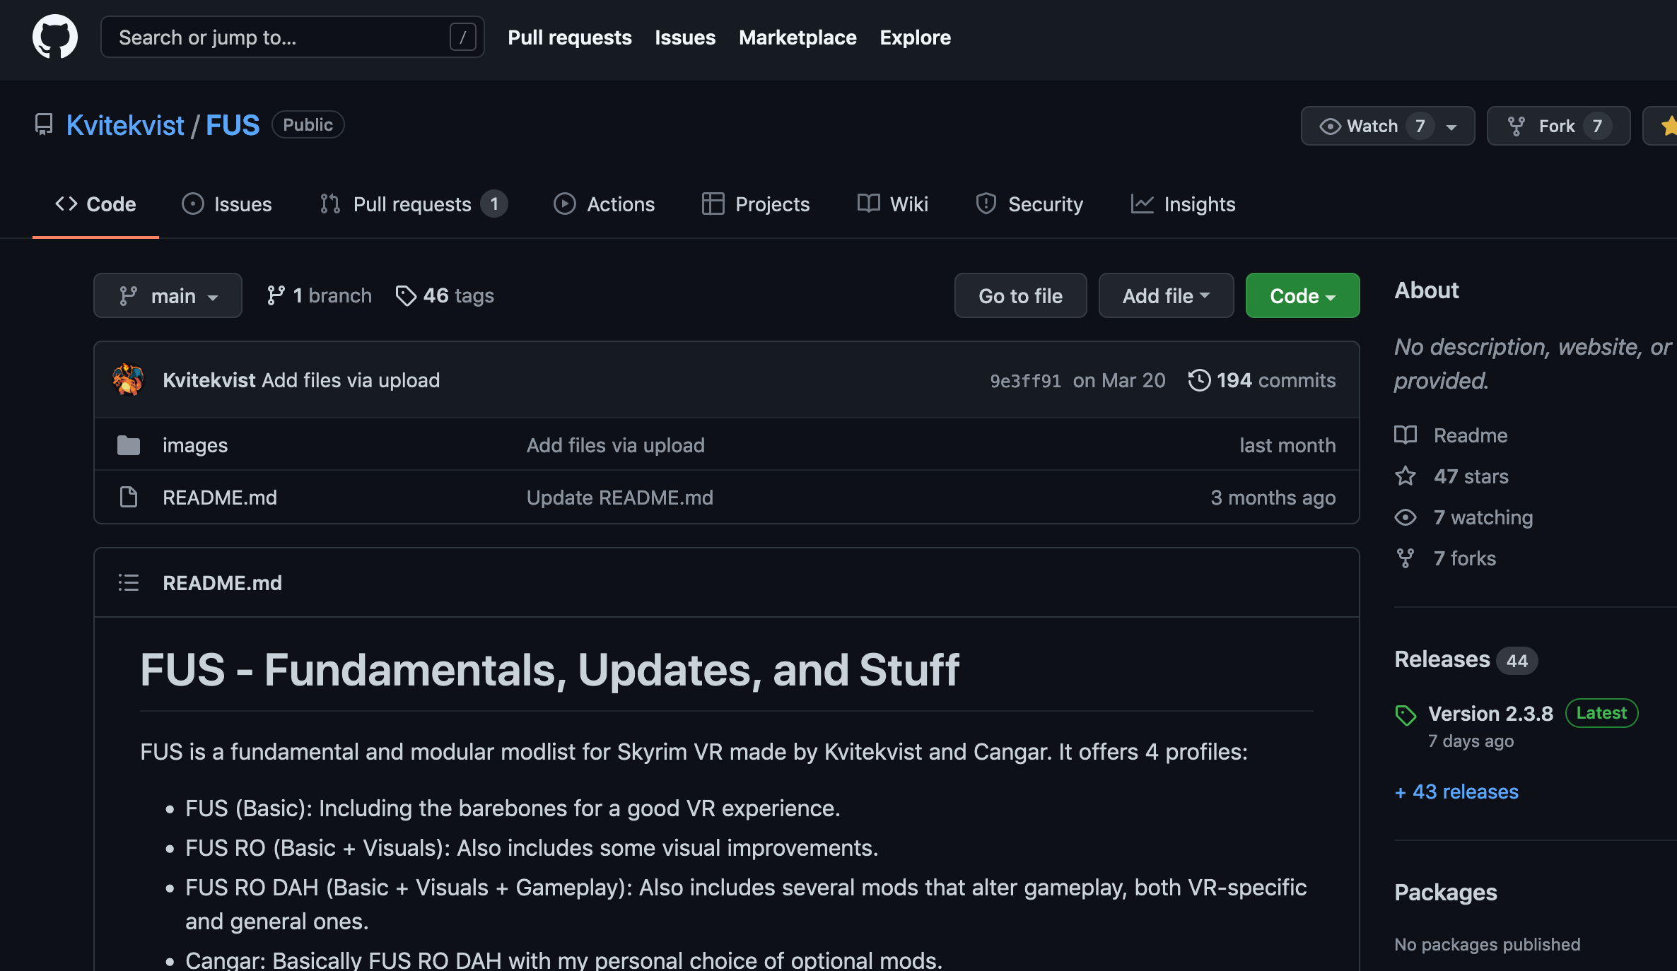

Notes:
As an example on how to collaborate with others.
If the upper left here shows “Public” as on the upper left, that doesn’t mean you can actually commit directly to a repo.

Slide 33

Notes:
As an example on how to collaborate with others.
If the upper left here shows “Public” as on the upper left, that doesn’t mean you can actually commit directly to a repo.

Slide 34
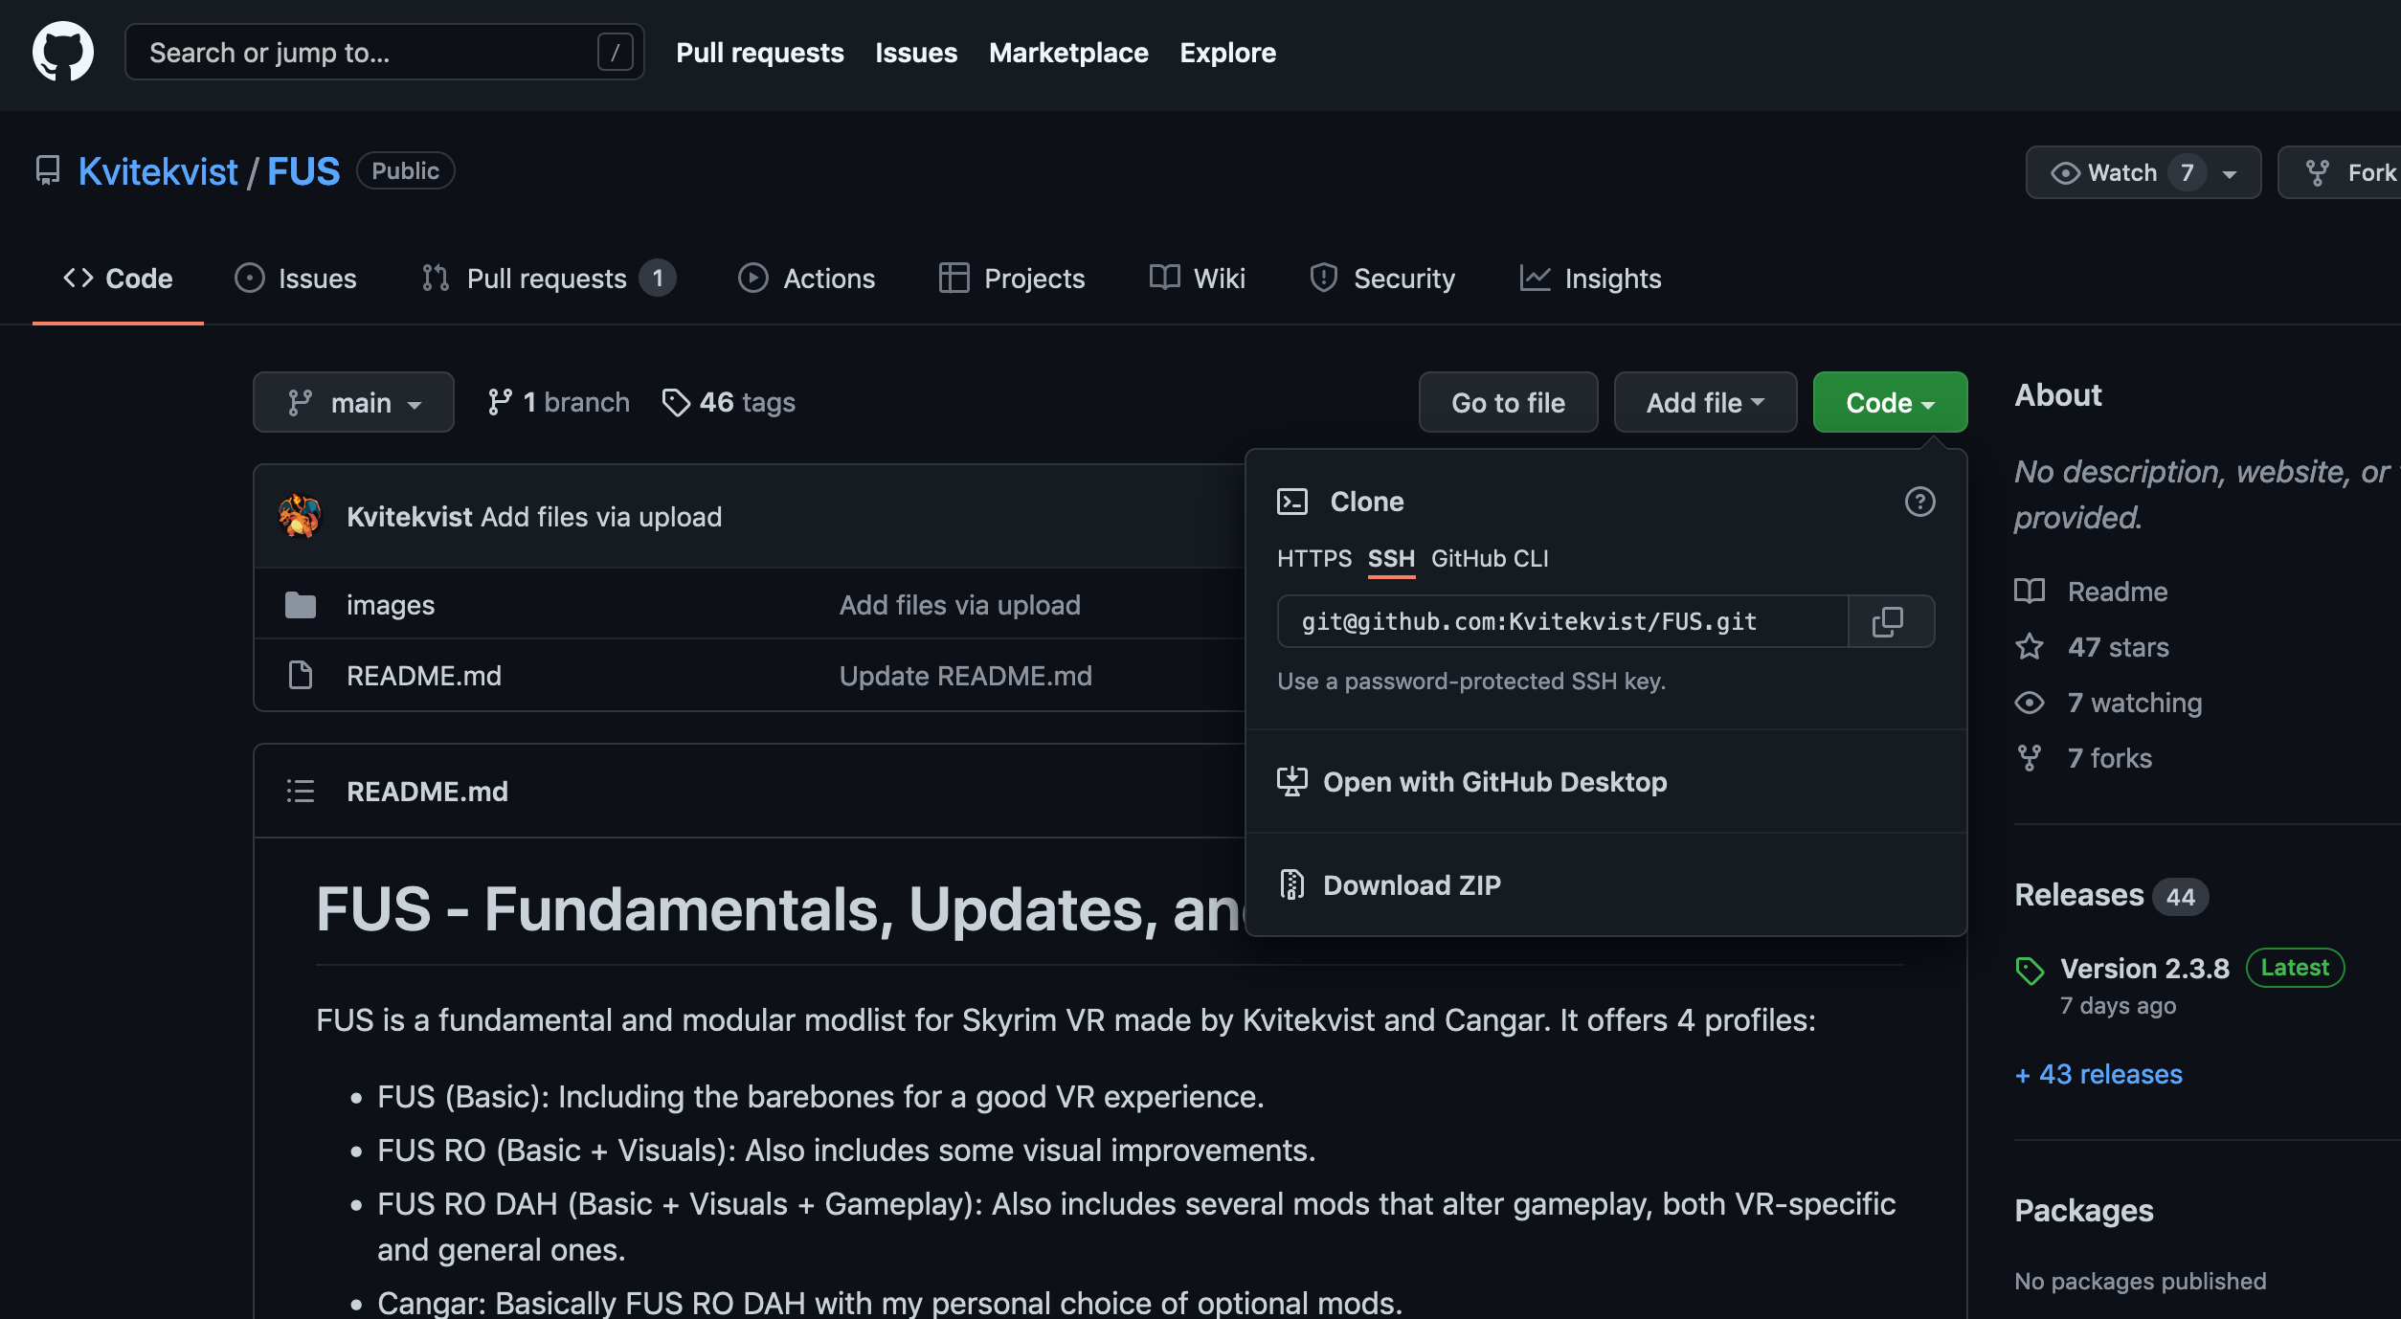
Notes:
As an example on how to collaborate with others.
If the upper left here shows “Public” as on the upper left, that doesn’t mean you can actually commit directly to a repo.

Slide 35
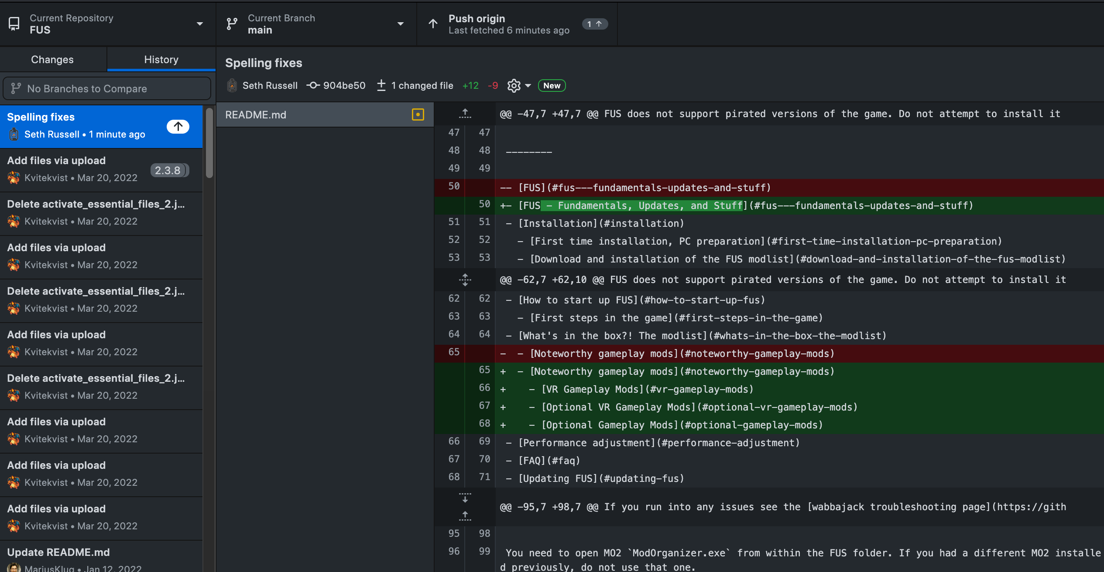
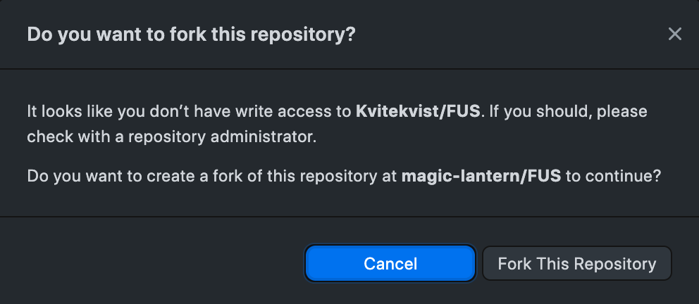
Collaborating with others
Notes:
One note – github desktop assumes that you have your edits in a branch and will only allow you to create pull requests from a branch. The actual github website does not have this limitation.

Slide 36
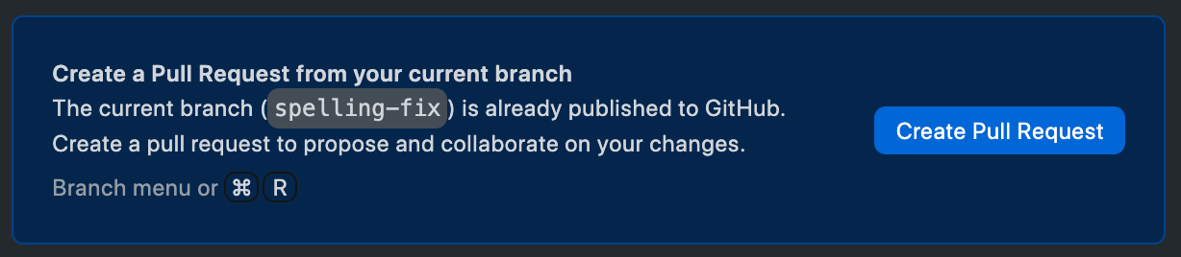
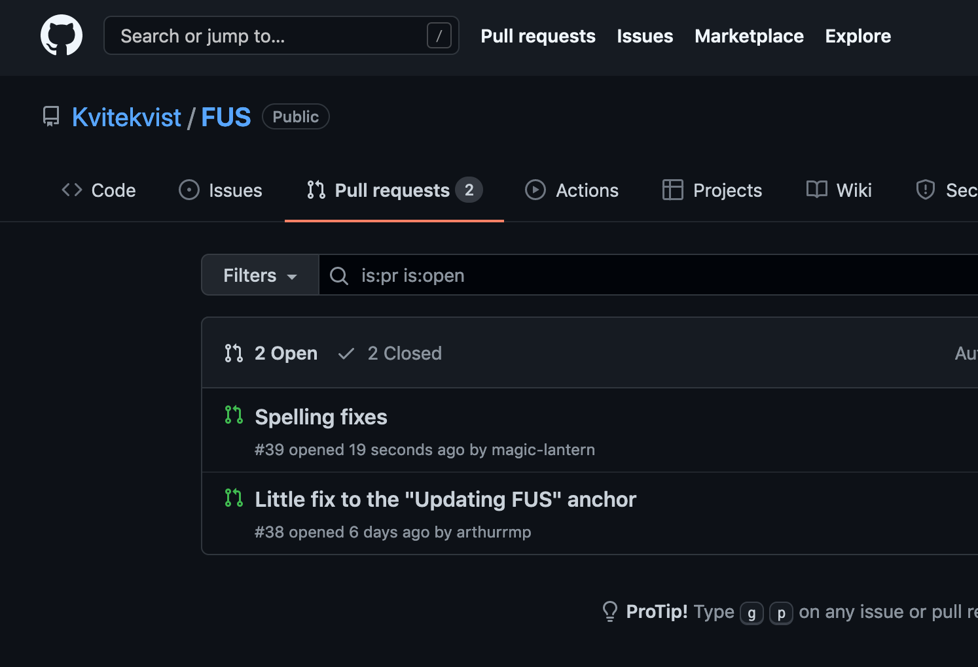
Collaborating with others
Notes:
One note – github desktop assumes that you have your edits in a branch and will only allow you to create pull requests from a branch. The actual github website does not have this limitation.
Once you’re done, and created your pull request you have to wait for project owners to take care of your request.
DEMO TIME – Create repo

Slide 37
Hands on Keyboard Time
https://github.com/magic-lantern/class-test-repo
Notes:
Items to demonstrate:
Create fork
Clone repo to local machine
Make change
Commit change
Push change
Create pull request

Slide 38
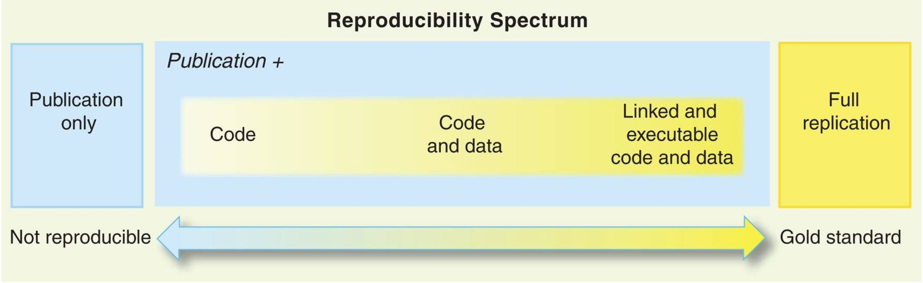
Git and Reproducible Science
Peng RD. Reproducible research in computational science. Science. 2011 Dec 2;334(6060):1226-7. doi: 10.1126/science.1213847. PMID: 22144613; PMCID: PMC3383002.
Notes:
Key Points
Open scientific work is more useful and more highly cited than closed.
Making Code Citable
Anything that is hosted in a version control repository (data, code, papers, etc.) can be turned into a citable object. You’ll learn how to do this in lesson 12: Citation.
How Reproducible Is My Work?
Ask one of your labmates to reproduce a result you recently obtained using only what they can find in your papers or on the web. Try to do the same for one of their results, then try to do it for a result from a lab you work with.
How to Find an Appropriate Data Repository?
Surf the internet for a couple of minutes and check out the data repositories mentioned above: Figshare, Zenodo, Dryad. Depending on your field of research, you might find community-recognized repositories that are well-known in your field. See also “Recommended Data Repositories“ from Nature.
How to Track Large Data or Image Files using Git?
Large data or image files such as .md5 or .psd file types can be tracked within a github repository using the Git Large File Storage open source extension tool. This tool automatically uploads large file contents to a remote server and replaces the file with a text pointer within the github repository.

Slide 39
Software Development tooling: Git questions?
Seth Russell – seth.russell@cuanschutz.edu
SOM, Dept of Pediatrics, Section of Informatics and Data Science
Code & Presentations: https://github.com/magic-lantern/bios6642-2022
Survey: https://forms.gle/yZNk6TQMKUP8y8eCA

